Slide 1
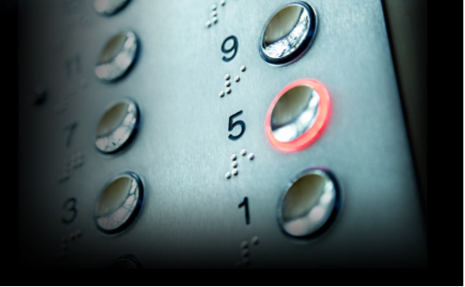
CONTROL SYSTEM FOR INCREASING THE EFFICIENCY OF MODERN ELEVATOR SYSTEMS

Slide 2
TEAM MEMBERS
SHUBHAM GUPTA (2012A7PS086P)
ANUBHAV GUPTA (2012A7PS093P)
VAMSI KRISHNA MEDA (2012A7PS196P)
RAVI SHANKAR PANDEY (2012C6PS676P)
ANMOL KUMAR GUPTA (2013B4A7588P)
HARMEET SINGH LAMBA (2013B4A7513P)

Slide 3
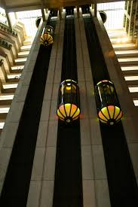
INTRODUCTION
Man Desire for comfort lead him to inventions and discoveries
Elevator, one of the remarkable invention
Today, Efficiency matters
Max output with Least power and minimum time.
Capsule Elevators

Slide 4
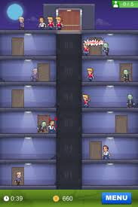
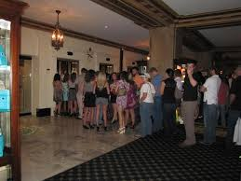
Why is the Need
Shortcoming
Long Waiting Time
Long Riding Time
High Power Consumption
Elevator Rush

Slide 5
Objective
Our objective is to simulate and increase the overall working efficiency of existing elevator system using Lab View software and JAVA.
Advantage: TRAVELLING TIME & thus POWER CONSUMPTION is reduced

Slide 6
Intelligent Elevator Control System
Controls analogous to human reasoning via fuzzy logic
Destination Floor
Fuzzy Logic Controller
Optimal Lift
No. Of Persons

Slide 7
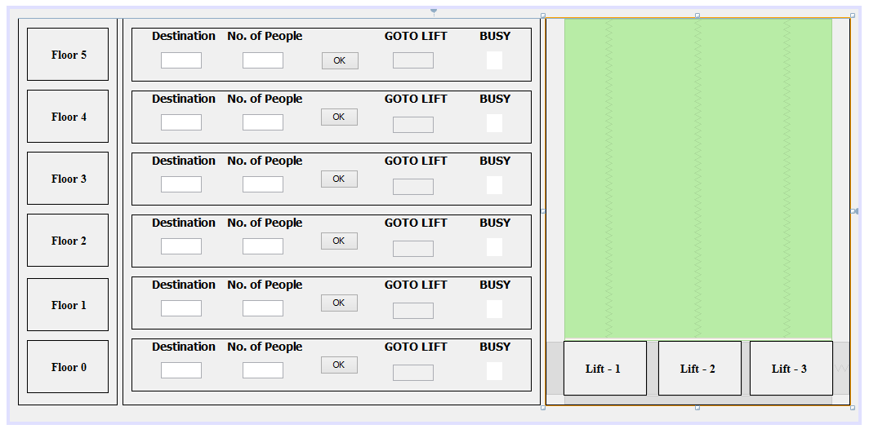
Control System

Slide 8
CRITERIA
To minimise the waiting time of passengers at a floor.
To minimise the time passengers need to spend in an elevator.
To minimise crowding in the elevator.
To minimise travelling distance of each elevator.

Slide 9
Formulae
1) RD: RELATIVE DISTANCE
RD= 0 (if lift is on way of called floor)
IF STATIONARY
RD= |STATIONARY FLOOR- CALLED FLOOR|
else
RD= |NEAREST DESTINATION FLOOR- CALLED FLOOR|
2) WT: WAITING TIME OF CALLER
Time an elevator takes from its current location to called floor
Assuming elevator takes 1 unit of time b/w 2 floors then,
WT= |CURRENT LOCATION - CALLED FLOOR|
3) FS: FREE SPACE OF ELEVATOR
FS= Total capacity - Current load of lift

Slide 10
Fuzzy Rules
S. No. | IF | ATTRIBUTE | THEN | ATTRIBUTE
1 | RD | Low | Priority | High
2 | RD | Med | Priority | Med
3 | RD | High | Priority | Low
4 | WT | Short | Priority | High
5 | WT | Med | Priority | Med
6 | WT | Long | Priority | Low
7 | FS | Small | Priority | Low
8 | FS | Med | Priority | Med
9 | FS | Large | Priority | High

Slide 11
Lab View Calculations Demo

Slide 12
JAVA Simulation Demo

Slide 13
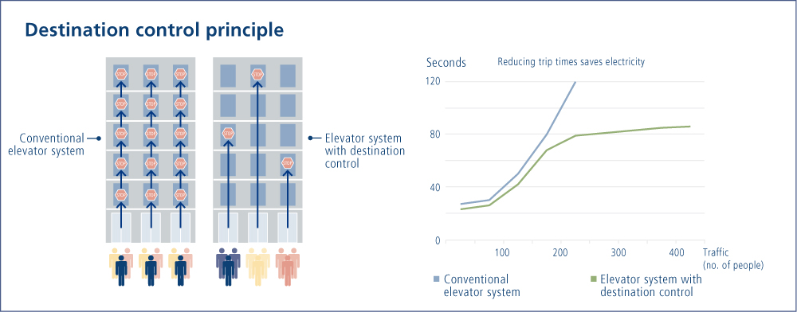
Results

Slide 14
Conclusion
By this we conclude that there is still very much scope in the improvement of the current elevator systems.
By using Fuzzy Rules and giving priorities to the Elevators, we determine the best elevator to the input hall call from the control system.
This saves time of the people and in turn power consumption.

Slide 15
Scope
If implemented on large scale, it can be a cost effective solution in near future.
It can be incorporated with Image Processing tools to automatically count the number of people waiting for an elevator

Slide 16
Thank You!

